Slide 2
Chapter Overview
Humans are adding greenhouse gases to Earth’s atmosphere.
Climate change will cause many severe problems in the ocean environment.
It is necessary to reduce and mitigate the effects of these changes.

Slide 3
Earth’s Climate System
Climate – long-term atmospheric conditions in a region
Temperature
Precipitation
Wind
Earth’s climate includes interactions of:
Atmosphere
Hydrosphere
Geosphere
Biosphere
Cryosphere

Slide 4
Earth’s Climate System
Climate system – exchanges of energy and moisture between Earth’s five spheres
Climate changes do not occur in isolation
Oceans are major component of Earth’s climate system

Slide 5
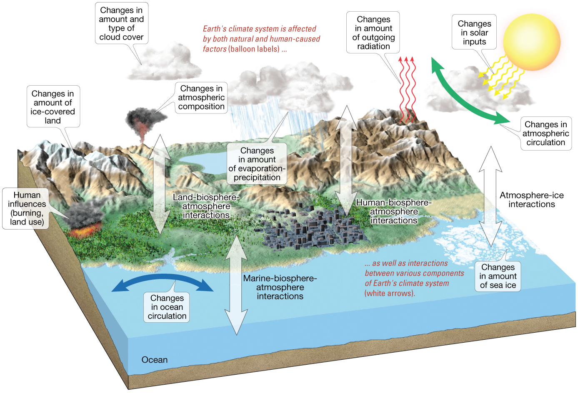
Earth’s Climate System

Slide 6
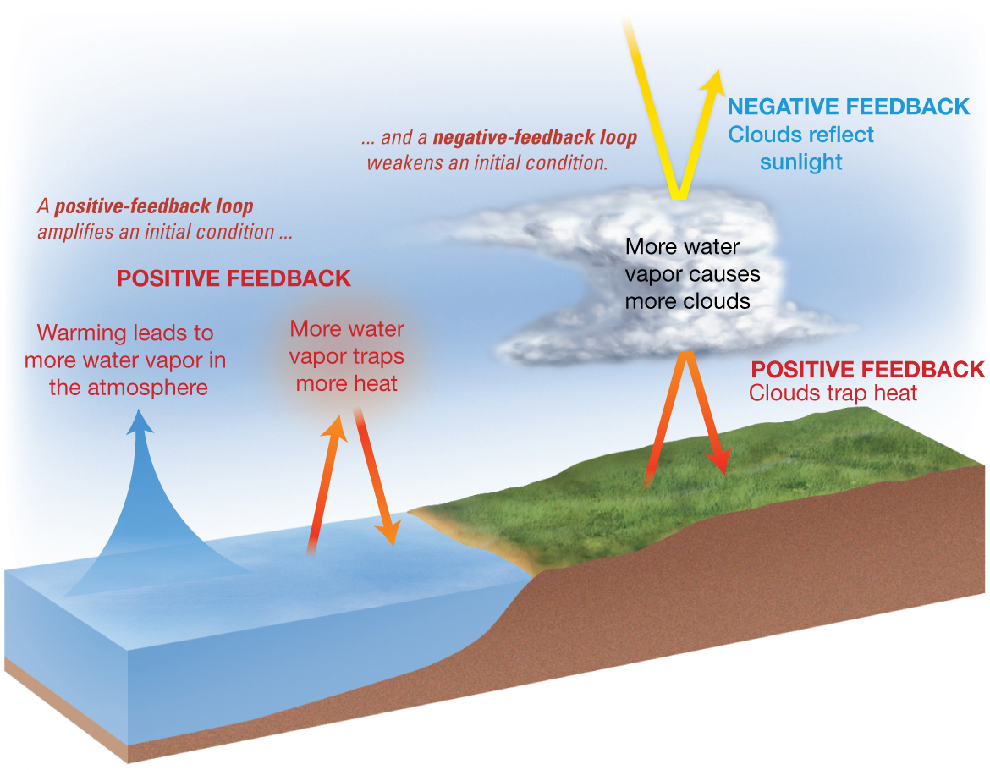
Earth’s Climate System
Feedback loops – modify atmospheric processes
Positive feedback loops – enhance initial change
Negative feedback loops – counteract initial change

Slide 7
Earth’s Climate System
Global climate system has many feedback loops
Components of feedback loops include
Aerosols
Air pollution
Water vapor
Ice reflectivity
Oceanic heat uptake

Slide 8
Determining Causes of Earth’s Climate Change
Paleoclimatology
Study of ancient climate
Paleoclimatologists study Earth’s past climates
Geologic evidence and other records of Earth’s past climates
Build computer models to understand how climate works
Monitor Earth’s current climate

Slide 9
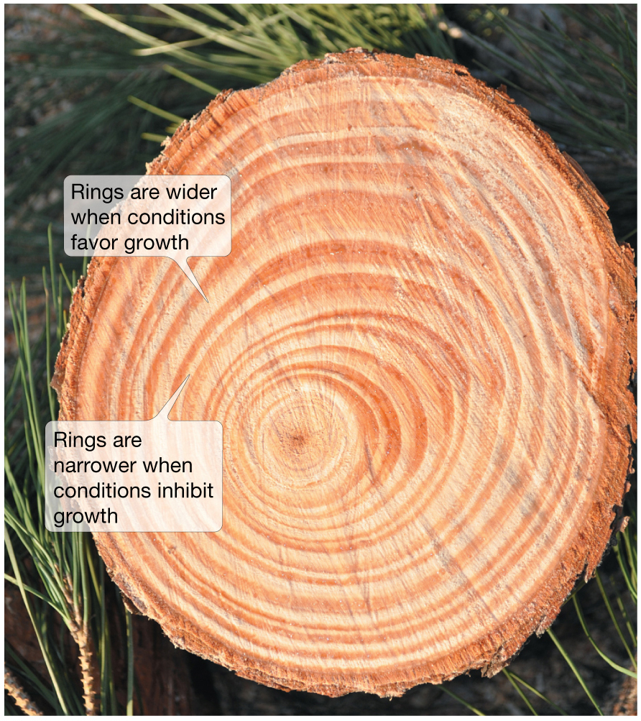
Determining Causes of Earth’s Climate Change
Proxy data – indirect evidence using natural recorders of climate variability
Sea floor sediments
Coral deposits
Glacial ice rings
Tree rings
Pollen
Historical documents

Slide 10
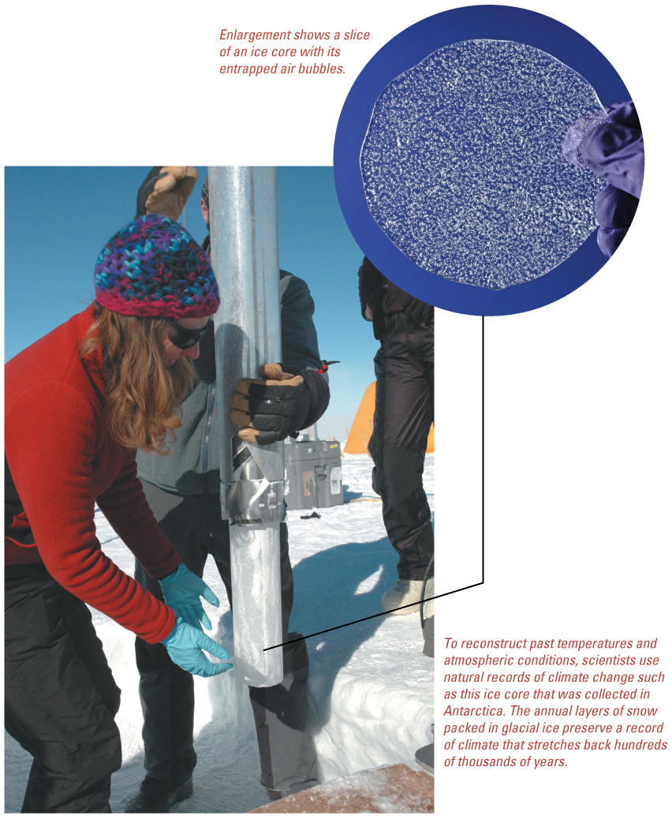
Proxy Data – Ice Cores

Slide 11
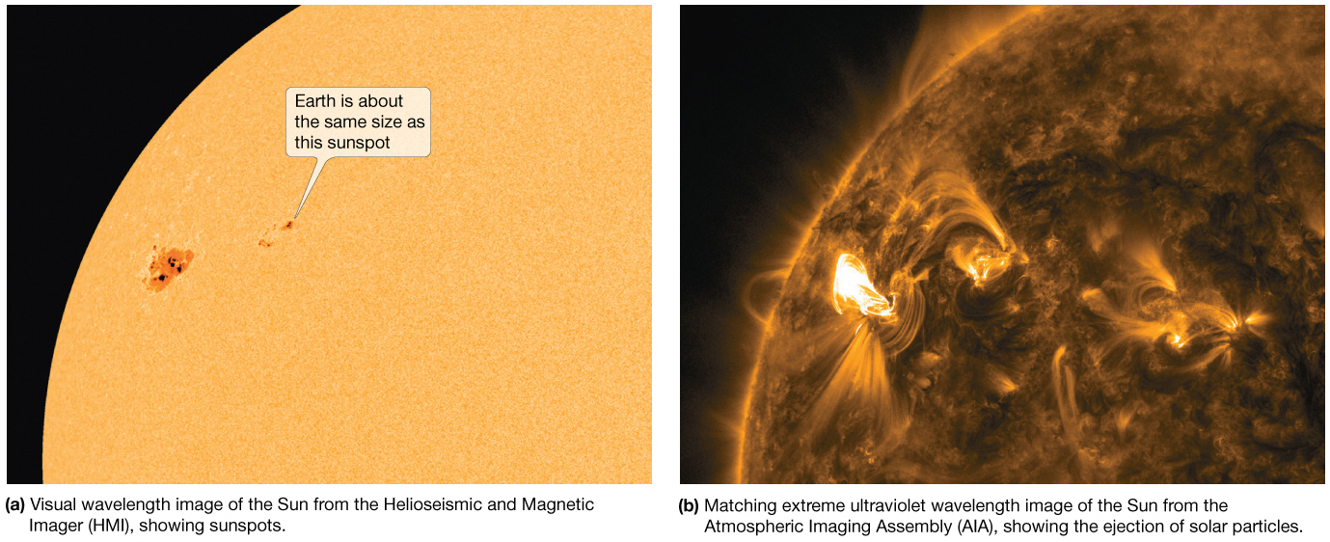
Natural Causes of Climate Change
Solar energy changes
Variable energy from the Sun over time
Luminosity
Sunspots – cooler, episodic dark areas on Sun
Faculae – bright spots on Sun

Slide 12
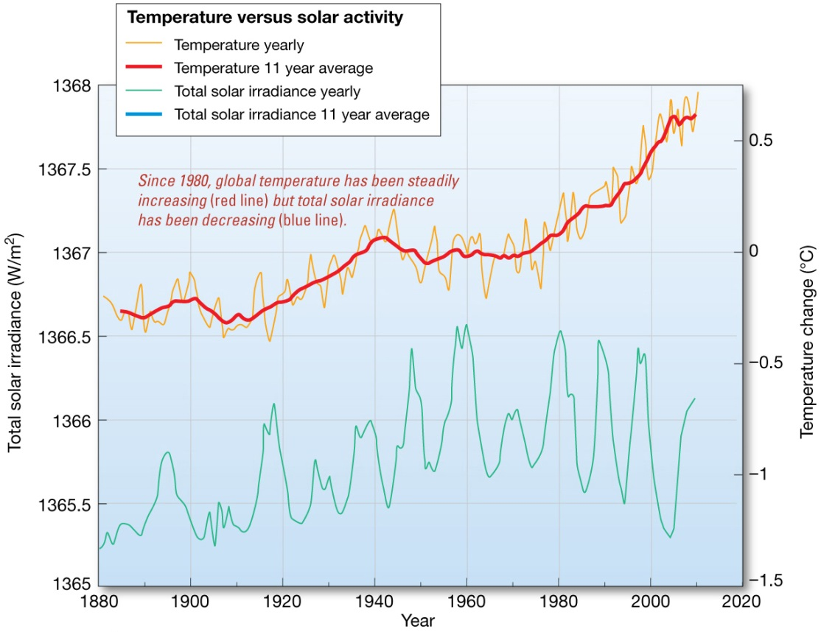
Natural Causes of Climate Change
Lack of correlation between solar activity and average Earth temperature.
Total solar irradiance increases with more sunspots

Slide 13
Natural Causes of Climate Change
Variations in Earth’s Orbit
Milankovitch Theories
Eccentricity of Earth’s orbit
Obliquity of Earth’s axis
Precession of Earth’s axis

Slide 14
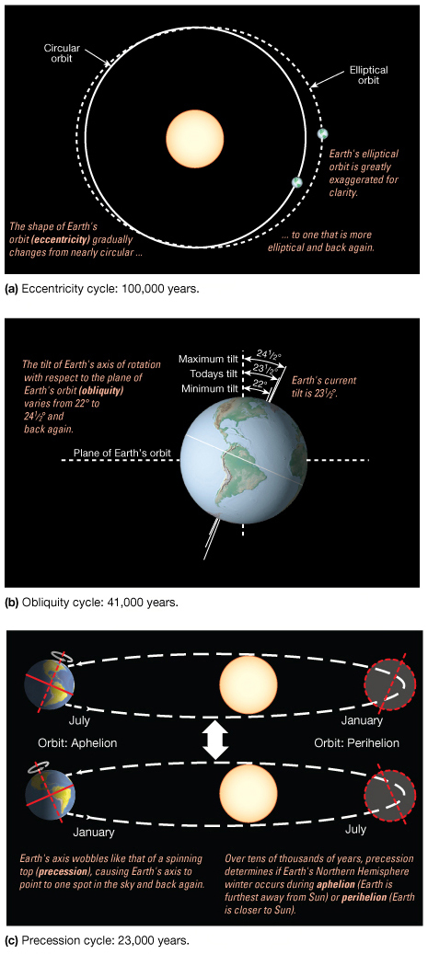
Variations in Earth’s Orbit

Slide 15
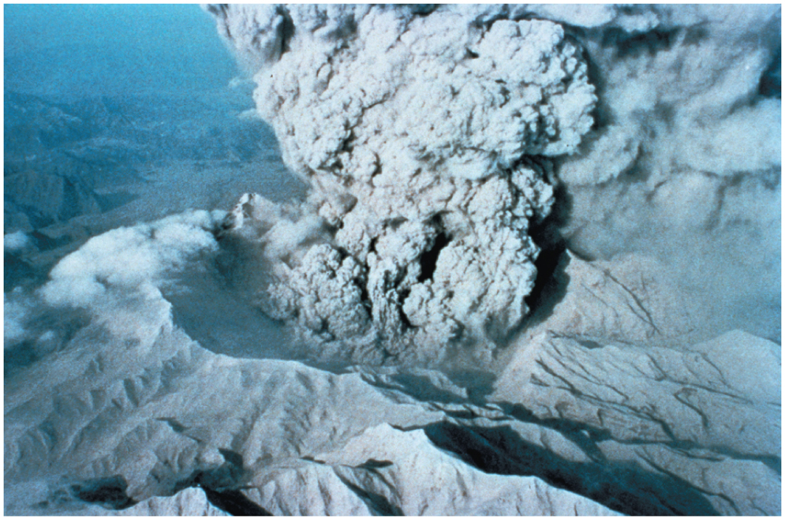
Natural Causes of Climate Change
Volcanic eruptions
Volcanic ejecta may block sunlight
Need many eruptions in short time period
Not observed in recent history

Slide 16
Natural Causes of Climate Change
Movement of Earth’s Plates
Change ocean circulation
Extremely slow process
Climate change would be very gradual over millions of years

Slide 17
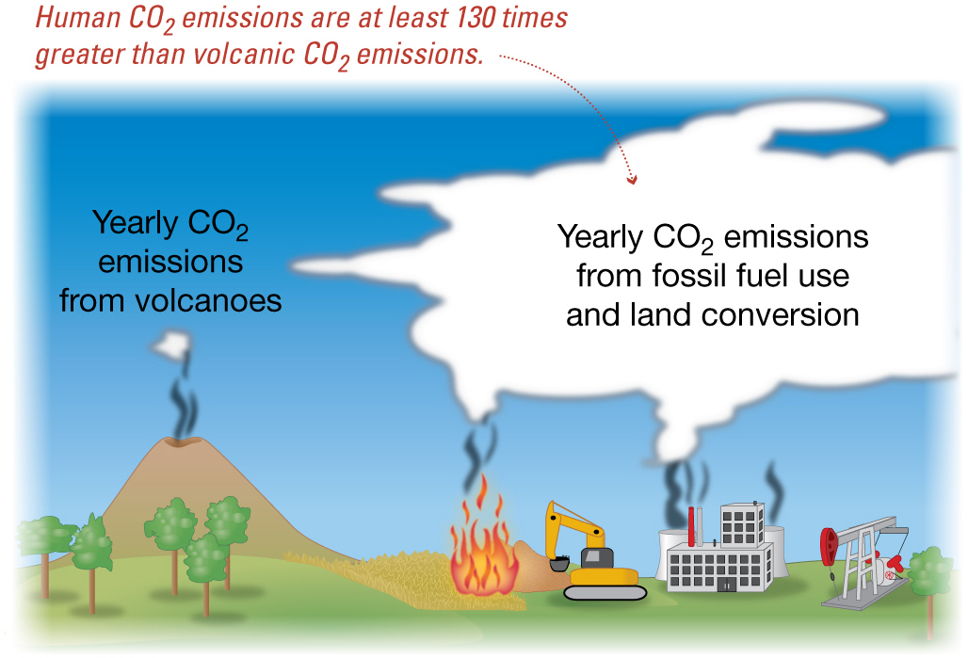
Natural Causes of Climate Change
Linked to Pleistocene Ice Age, Little Ice Age, Medieval Warm Period
Recent change unprecedented
More likely result of human activity than natural causes

Slide 18
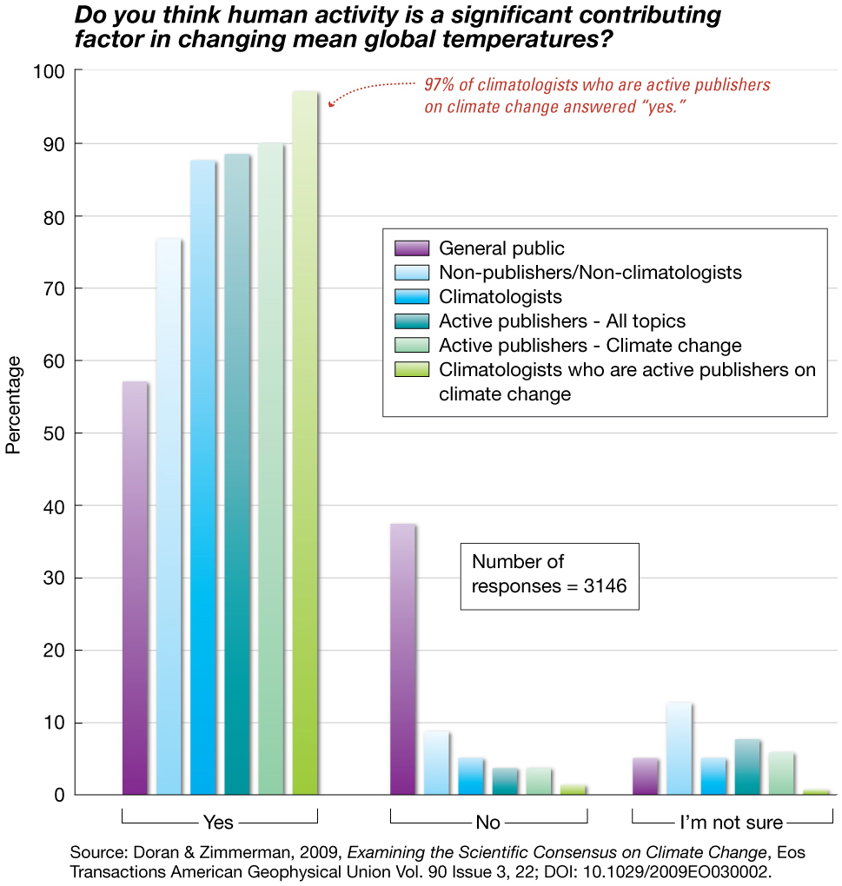
Natural vs. Human Caused Climate Change
Scientific consensus of large human contribution

Slide 19
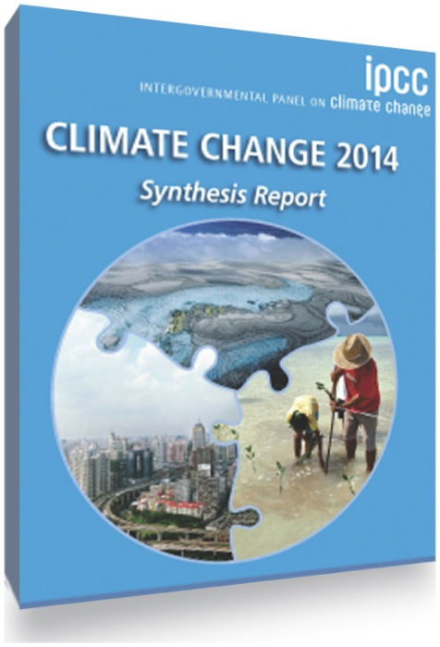
Documenting Human-Caused Climate Change
Intergovernmental Panel on Climate Change (IPCC)
Global group of scientists
Peer-reviewed literature
Published assessments since 1990
Predict global temperature changes of 1.4–5.8°C (2.5–10.4°F)

Slide 20
Documenting Human-Caused Climate Change
Climate change models can mimic modern conditions only if human emissions are taken into account.
IPCC assessments continue to provide strong documentation of human-induced climate change.

Slide 21
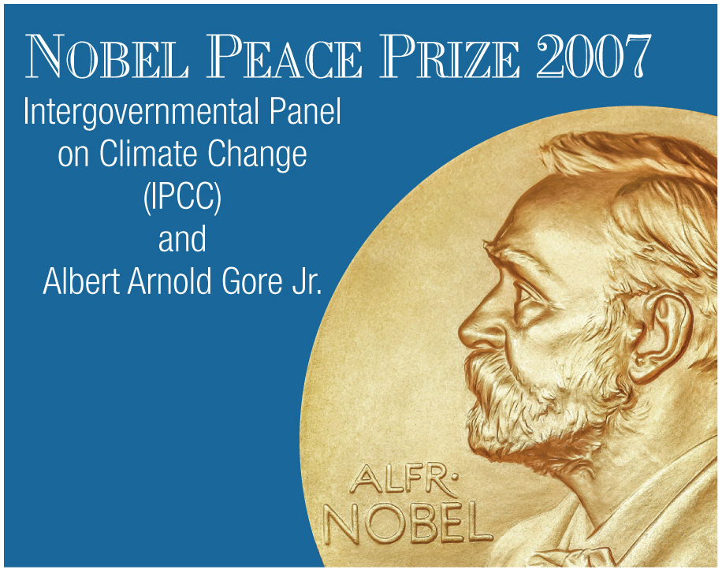
Documenting Human-Caused Climate Change
IPCC and Al Gore Jr. shared 2007 Nobel Peace Prize for “their efforts to build up and disseminate greater knowledge about man-made climate change….”

Slide 22
Documenting Human-Caused Climate Change
Other scientific reports confirm IPCC findings
U.S. Global Change Research Program – 1990
Global warming is unequivocal and primarily human-induced.
Global average temperature risen 1.5°F (0.8°C) since 1900.
U.S. National Research Council – 2011
Actions taken now can reduce risk of major disruptions to human and natural systems

Slide 23
Documenting Human-Caused Climate Change
U.S. National Climate Assessment Report – 2014
More than 300 experts
60-member Federal Advisory Committee
Affirms humans as primary cause of Earth’s recent climate changes

Slide 24
Atmosphere’s Greenhouse Effect
Global warming – increase in Earth’s global temperatures
Greenhouse effect – keeps Earth’s surface habitable
Incoming heat energy is shorter wavelengths
Longer wavelengths – some trapped, some escape, net warming effect

Slide 25
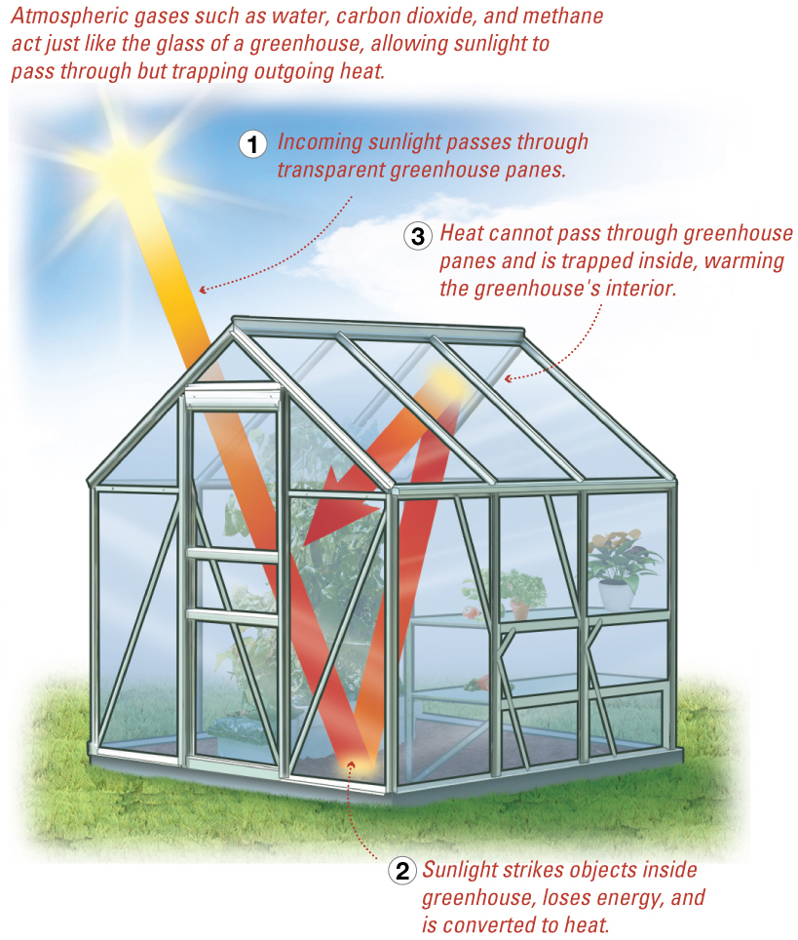
Atmosphere’s Greenhouse Effect

Slide 26
Earth’s Heat Budget
Heat Budget – addition to or subtraction from heat on Earth
Incoming radiation from Sun–shorter wavelengths
Outgoing radiation from Earth–longer wavelengths
Rates of energy absorption and re-radiation must be equal

Slide 27
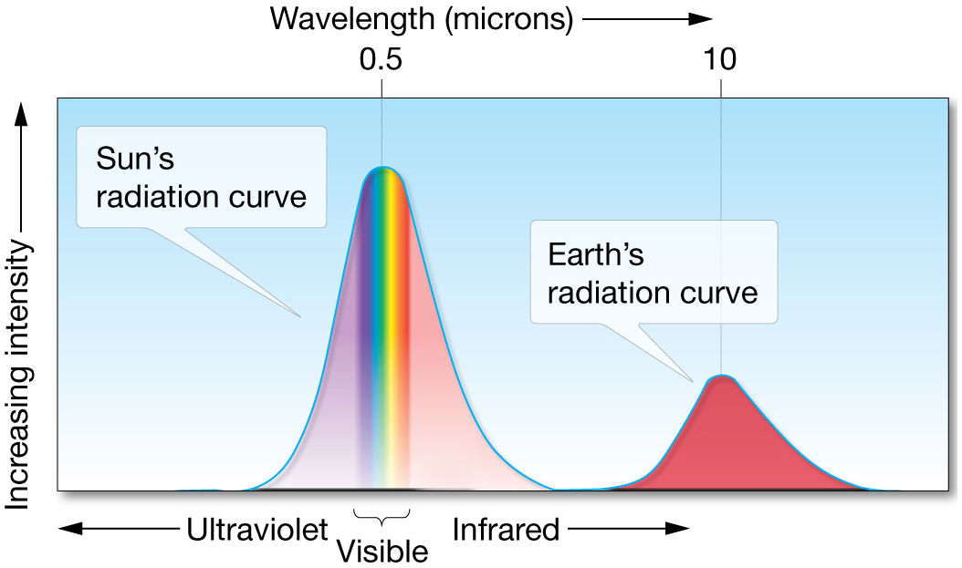
Earth’s Heat Budget

Slide 28
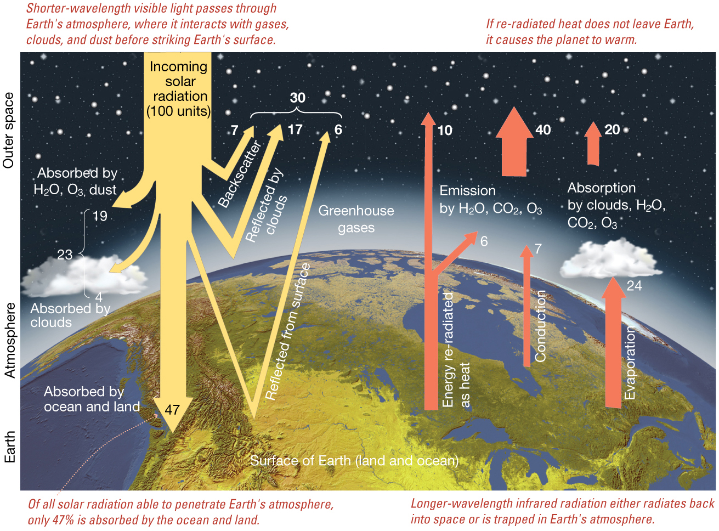
Earth’s Heat Budget

Slide 29
Greenhouse Gases
Water vapor
Most important
66–85% of greenhouse effect
Carbon dioxide
Natural part of atmosphere
Greatest relative contribution from human activities
Burning of fossil fuels

Slide 30
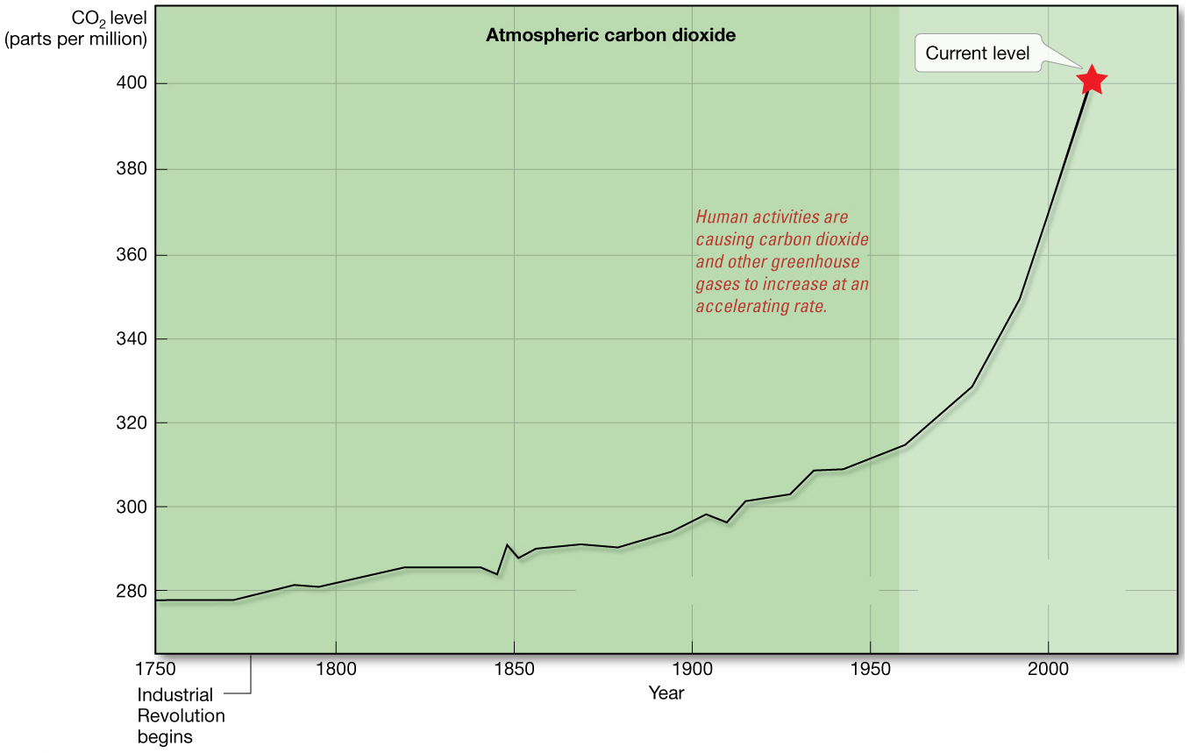
Atmospheric Carbon Dioxide

Slide 31
Greenhouse Gases
Methane
Second most abundant human-caused greenhouse gas
Great warming power per molecule
Landfill decomposition
Cattle
Other trace gases
Nitrous oxide, CFCs, ozone

Slide 32
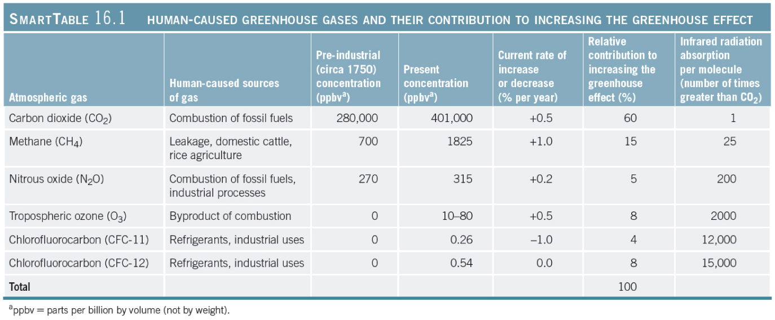
Human-Caused Greenhouse Gases

Slide 33
Greenhouse Gases Past and Future
Continuous ice core data from Antarctica records past atmospheres
Carbon dioxide varied from 180 to 280 ppm
High levels of carbon dioxide and methane today

Slide 34
Greenhouse Gases Past and Future
Paleocene-Eocene Thermal Maximum (PETM) 56 million years ago
Earth’s climate much warmer than today
Huge release of carbon dioxide and methane
Massive ocean ecosystem changes from increased ocean temperatures

Slide 35
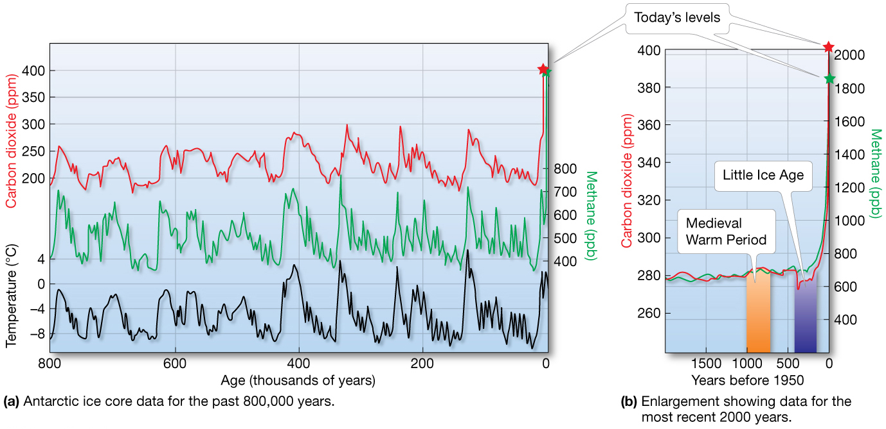
Ice Core Data

Slide 36
Future scenarios from Global Warming
Melting glaciers and ice caps
Shorter winters
Species distribution shifts
Global temperature rise
Sea surface temperature increases
Earth would continue to warm even if greenhouse gas concentrations stabilized today.

Slide 37
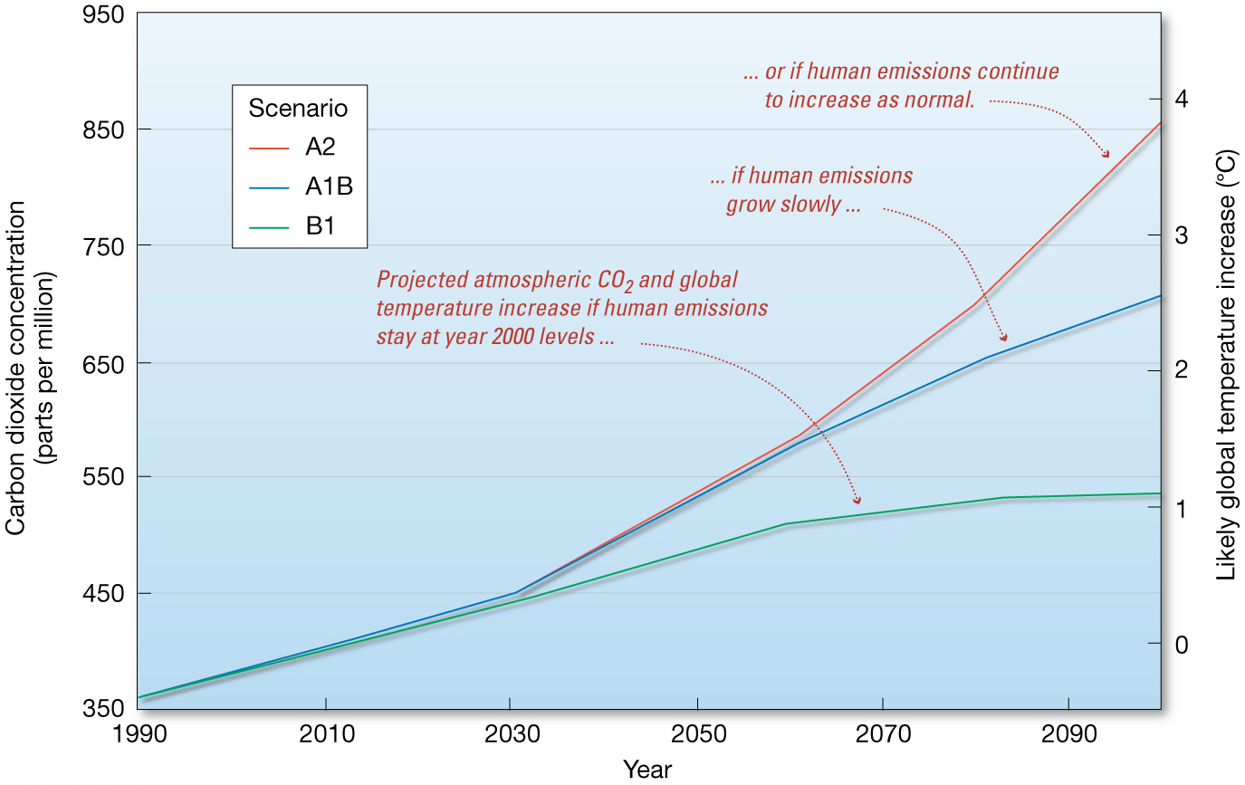
Future scenarios from Global Warming

Slide 38
Other considerations
Aerosols
Suspended particles in atmosphere
Affect atmosphere’s reflectivity and ability to trap heat
Black carbon or soot – 1 gram is 100 to 2000 times more potent than equal amount of carbon dioxide for global warming
Lowers Earth’s surface albedo

Slide 39
Documented Changes due to Global Warming
Increase in Earth’s average surface temperatue
Rate of warming in last 50 years double that of past 100 years
Warmest years on instrumental record since 2000
Sea surface temperatures increased worldwide
Increasing severe heat waves

Slide 40
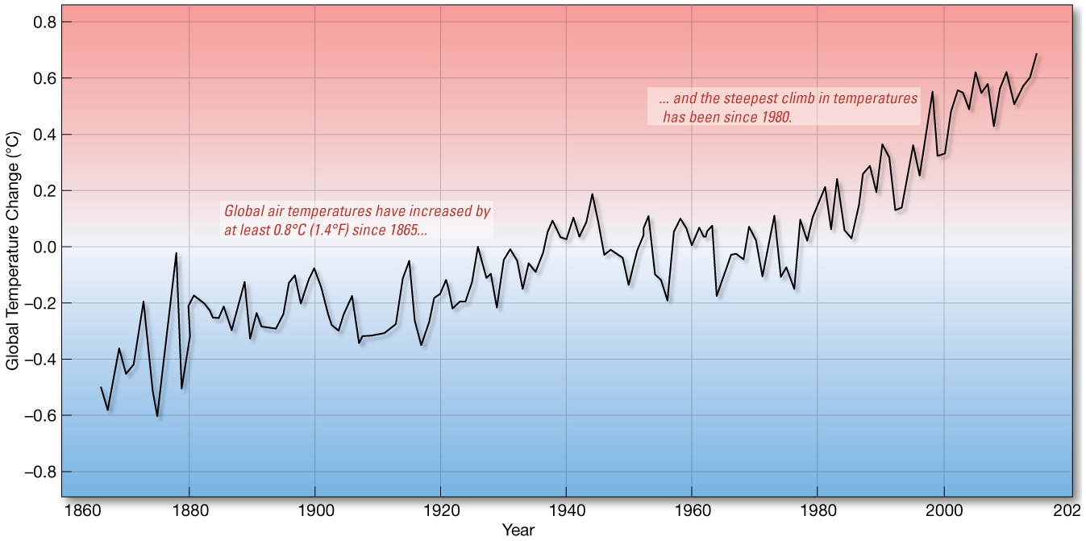
Thermometer recordings of surface air temperature

Slide 41
Predicted Changes from Global Warming
Earlier, hotter summers
More severe droughts in some places, flooding in others
Retreat of mountain glaciers
Water contamination issues
Ecosystem changes and extinctions
Increased biological productivity in plants
Ice-free arctic waters with higher oceanic productivity

Slide 42
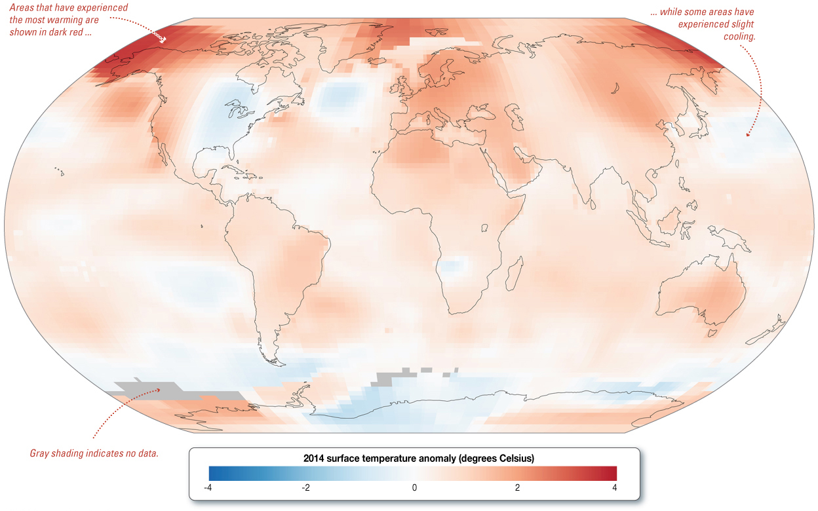
Changes in the Oceans
Increasing ocean temperatures
Sea surface temperatures risen mostly since 1970
Deep waters showing increases

Slide 43
Changes in the Oceans
Increased hurricane activity
Warmer water fuels hurricanes
Severity of recent Atlantic hurricanes
Number of global tropical storms have not increased worldwide
Intensity of storms has increased
More Category 4 and 5 hurricanes

Slide 44
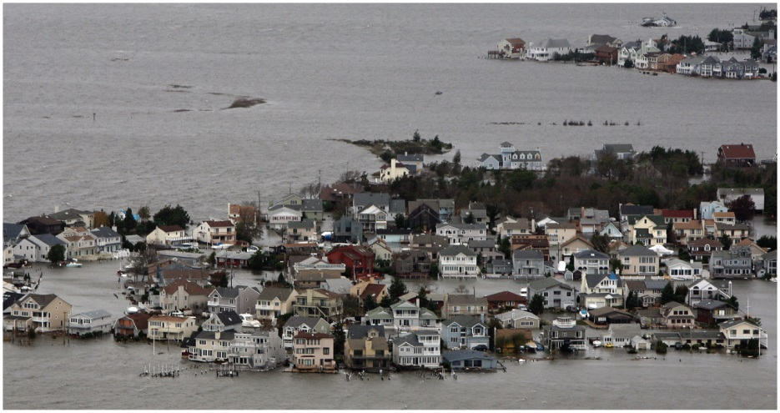
Changes in the Oceans

Slide 45
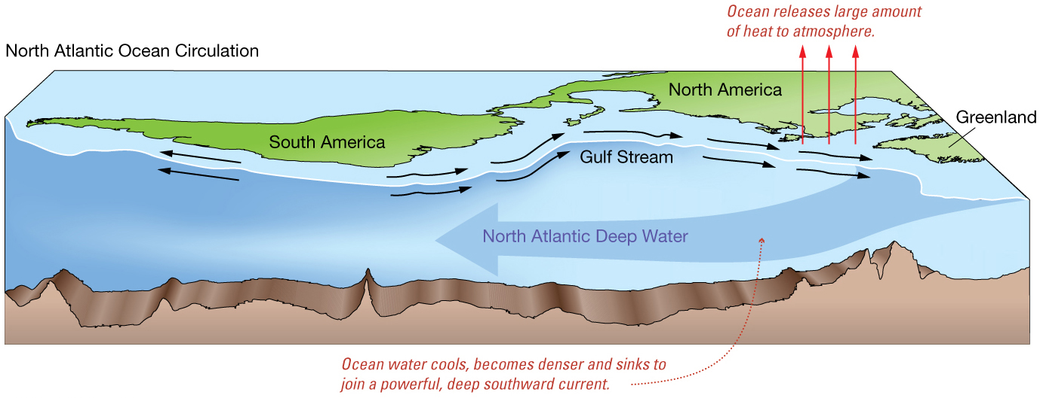
Changes in the Oceans
Changes in deep-water circulation
North Atlantic especially sensitive
Melting glaciers
Warmer surface waters

Slide 46
Changes in the Oceans
Polar Ice Melting
Arctic amplification
Loss of more than 2 million square kilometers (800,000 square miles) of Arctic sea ice in last decade
Loss of ice = enhanced warming due to lower albedo

Slide 47
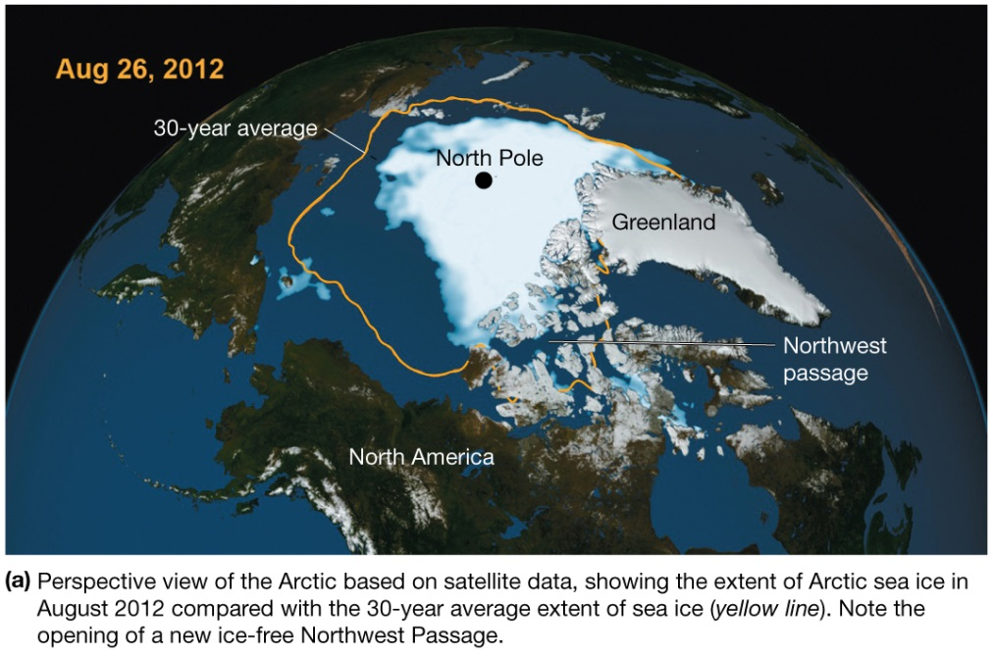
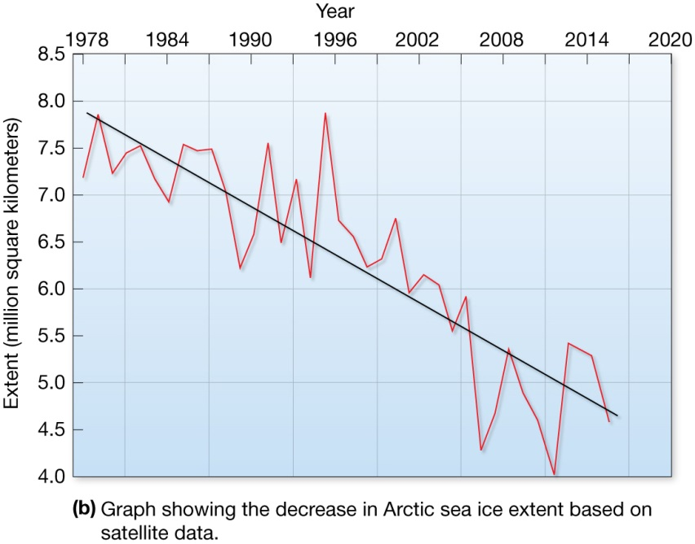
Arctic sea ice decline

Slide 48
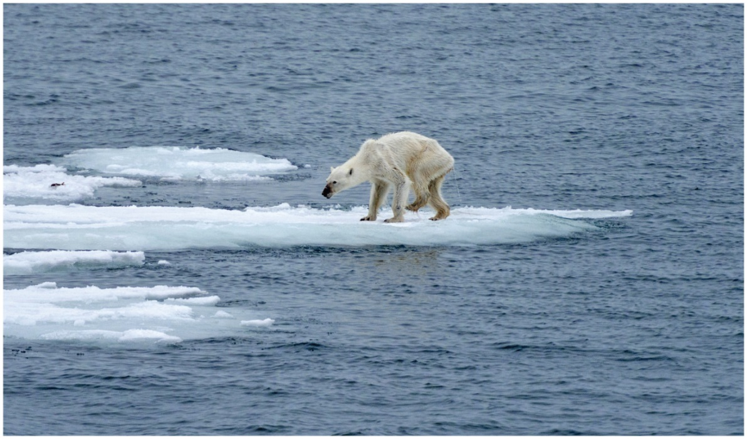
Changes in the Oceans
Polar Ice Melting
Arctic ice melting affects polar bear survival.
Food sources are dwindling for human Arctic dwellers.
Marine species migration

Slide 49
Changes in the Oceans
Polar Ice Melting
Antarctica shrinking, glaciers thinning
Larsen Ice Shelf decreased more than 40% over last decade.
200 billion metric tons of ice lost in 2006 alone
Byrd Station in West Antarctica one of the fastest-warming places on Earth

Slide 50
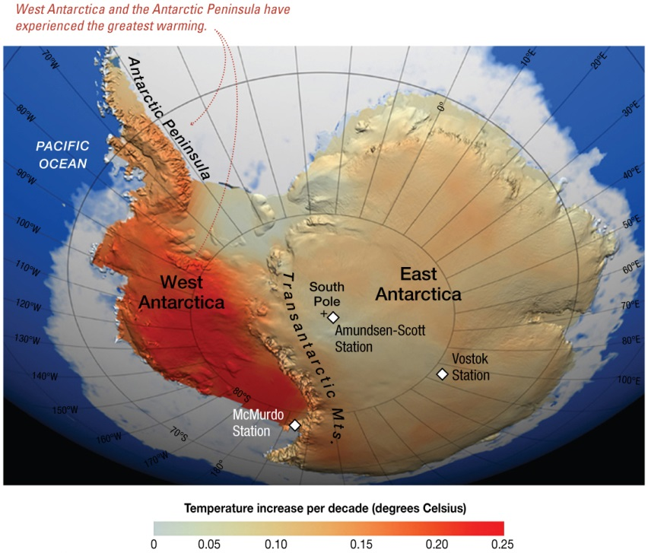
Changes in the Oceans

Slide 51
Changes in the Oceans
Ocean acidification
Some atmospheric carbon dioxide dissolves in ocean water.
pH difference of 0.1 = 30% increase in hydrogen ion concentration
pH decline threatens calcifying organisms
Coccolithophores
Foraminifers
Sea urchins
Corals

Slide 52
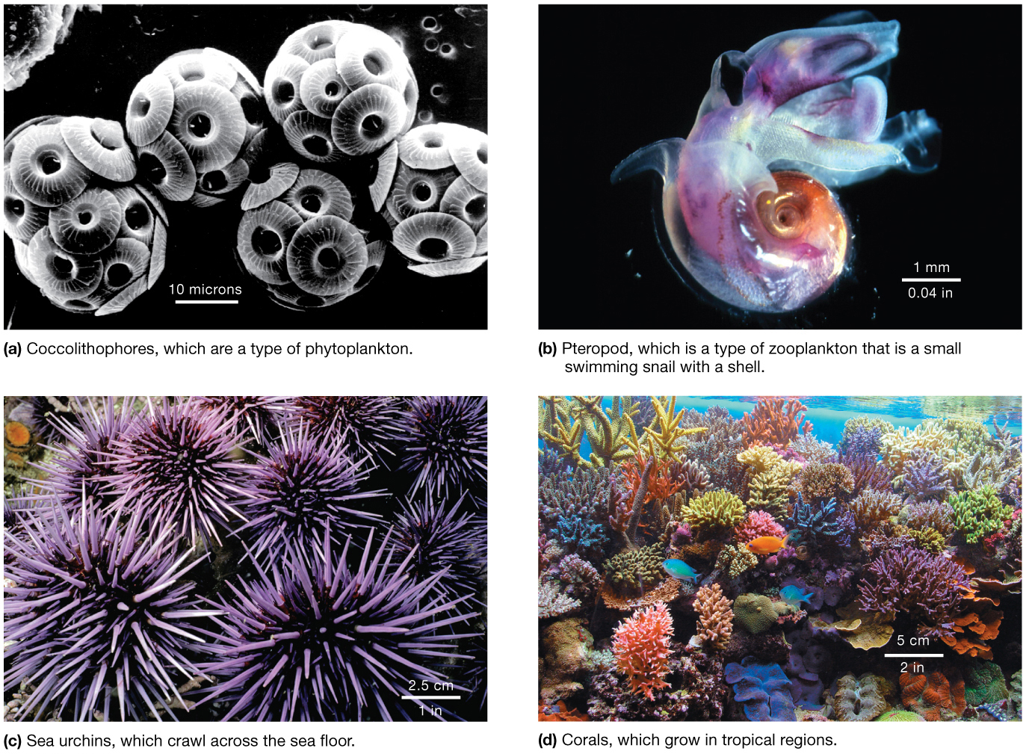
Marine organisms affected by increased ocean acidity

Slide 53
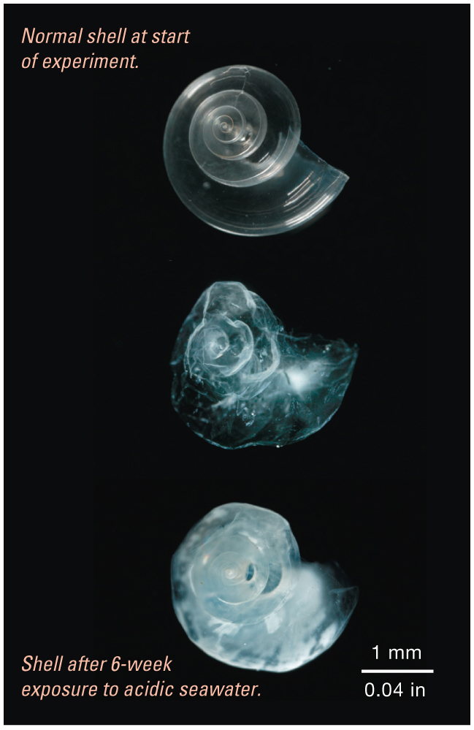
Pteropods dissolved by acidic waters

Slide 54
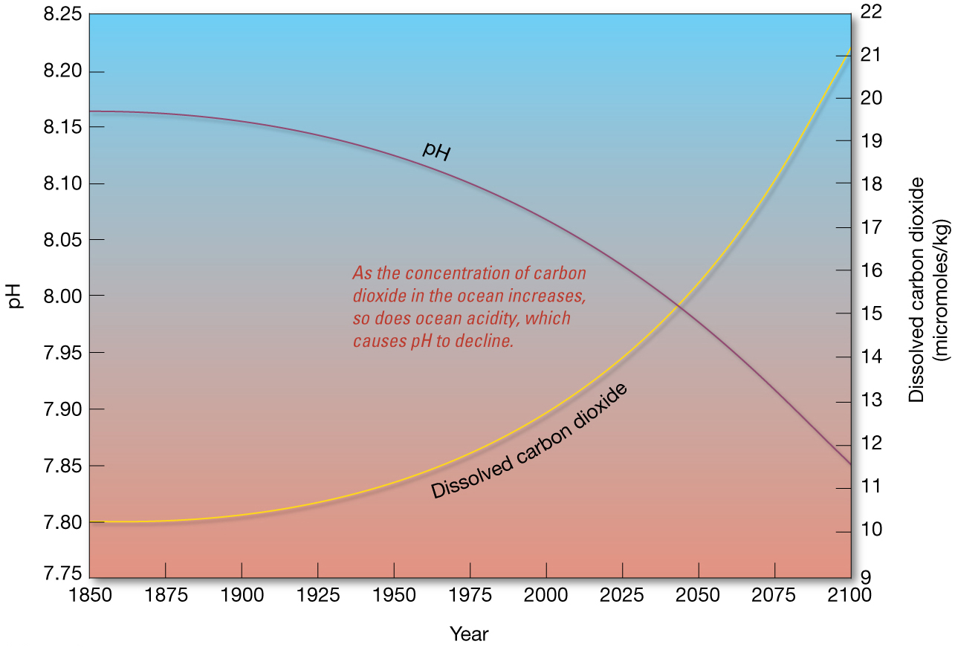
Dissolved carbon dioxide and ocean pH

Slide 55
Changes in the Oceans
Rising Sea Level – already occurring
Main contributors:
Melting of Antarctic and Greenland ice sheets
Thermal expansion of ocean surface waters
Melting of land glaciers and ice caps
Thermal expansion of deep-ocean waters

Slide 56
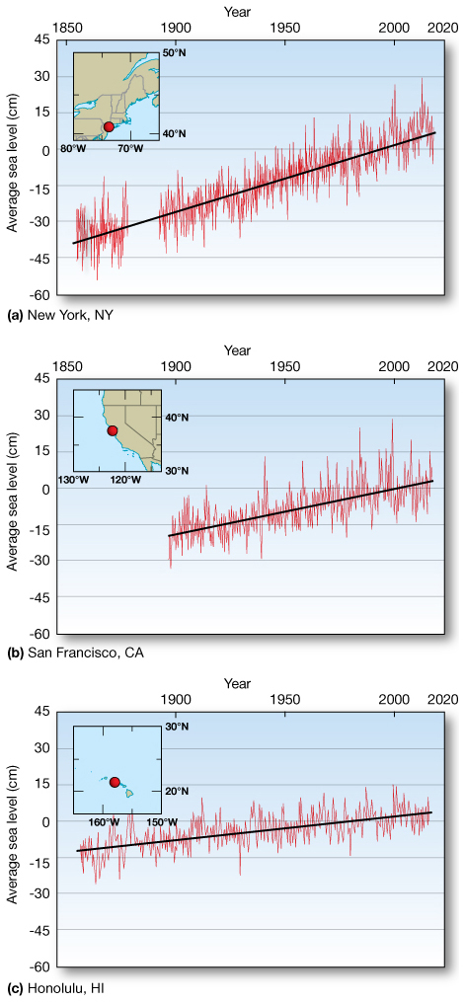
Changes in the Oceans

Slide 57
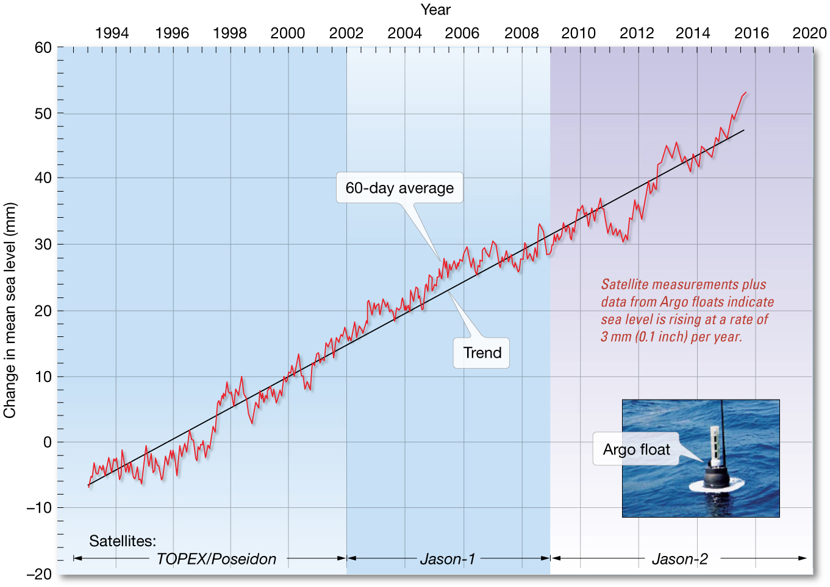
Global Sea Level Rise Determined by Satellites

Slide 58
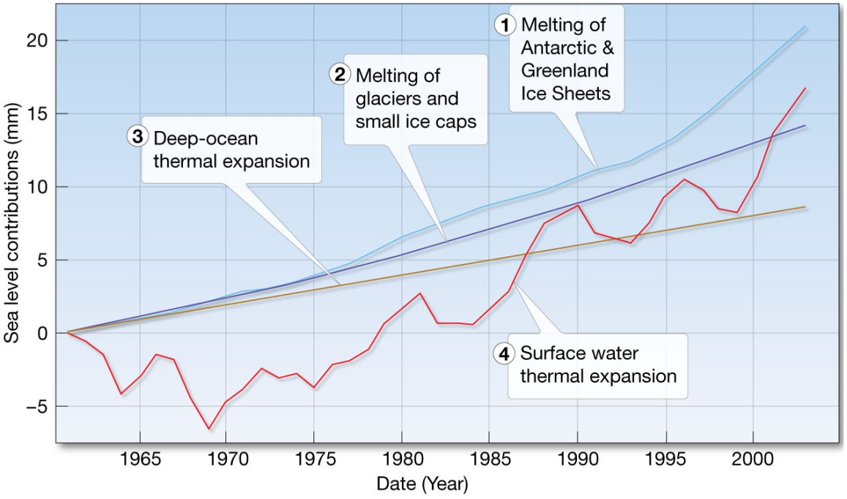
Rising Sea Level
Severely affect areas with gently sloping coastlines
U.S. Atlantic and Gulf Coasts
Models predict rise between 0.5 and 1.4 meters (1.6 and 4.6 feet) by year 2100

Slide 59
Changes in the Oceans
Other predicted changes
Sound transmission in ocean
Reduced dissolved oxygen – marine dead zones
Increased wind speeds and wave heights

Slide 60
Changes in the Oceans
Migration of mangroves
Florida’s mangroves migrating north
Oceanic productivity
Increased ocean stratification and stronger thermocline
Decreased productivity due to diminished upwelling
Decline in global phytoplankton biomass

Slide 61
Changes in the Oceans
Effect on Marine organisms
Many organisms sensitive to water temperature changes
Change in populations of various fish groups
Migration of marine organisms to deeper waters and towards poles

Slide 62
Reducing Greenhouse Gases
Human emissions contributing excessive CO₂
Global engineering – attempts to counteract human-caused climate change
Reducing sunlight reaching earth
Removing human-caused greenhouse gases

Slide 63
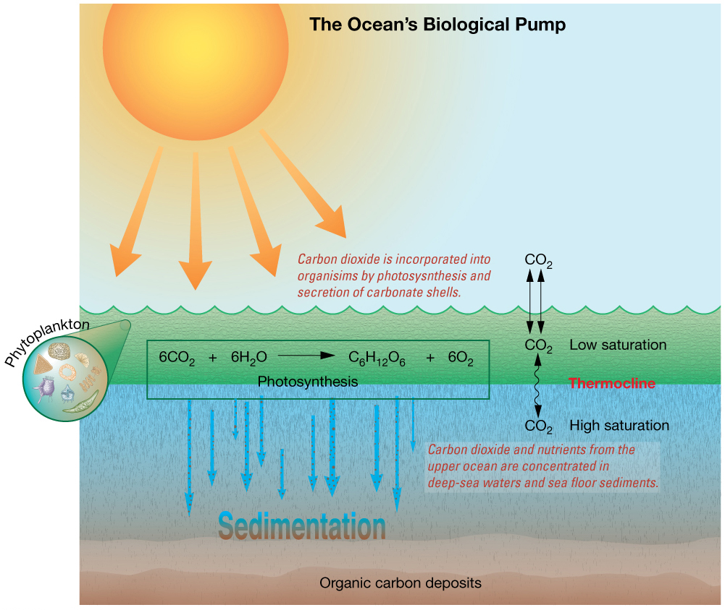
Reducing Greenhouse Gases
Ocean’s Role
Ocean’s biological pump
“Sink” for carbon dioxide
Pumps from surface to deep waters

Slide 64
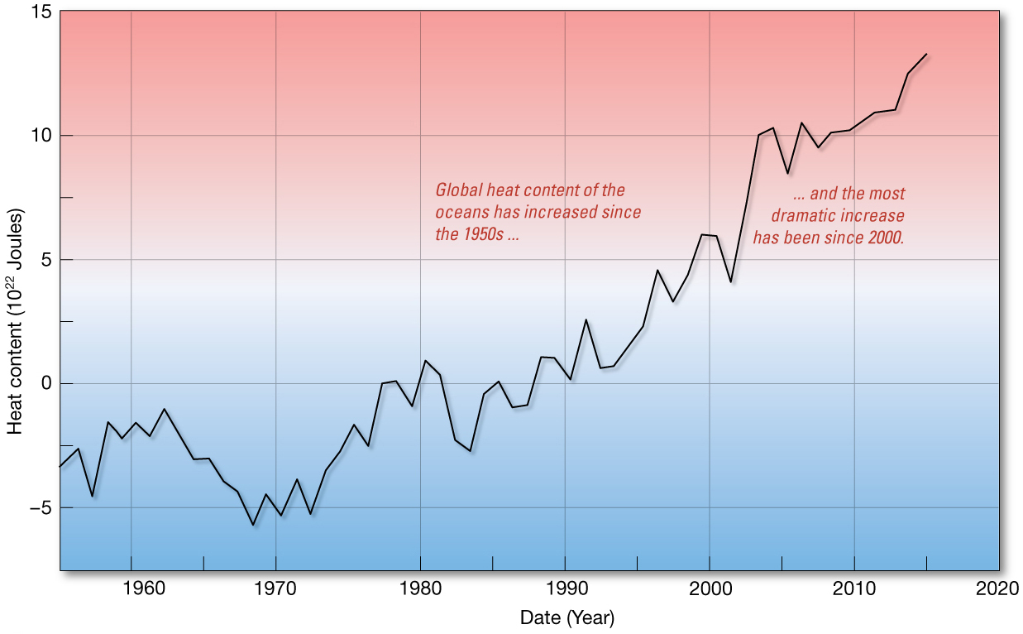
Reducing Greenhouse Gases
Ocean as thermal sponge
Unique thermal properties of water
Oceans absorb much heat without changing temperature
Oceans still warming

Slide 65
Possibilities for Reducing Greenhouse Gases
Iron hypothesis
Fertilize ocean to increase productivity
Increase phytoplankton, increase carbon dioxide removal from atmosphere
Sequestering excess carbon dioxide in oceans

Slide 66
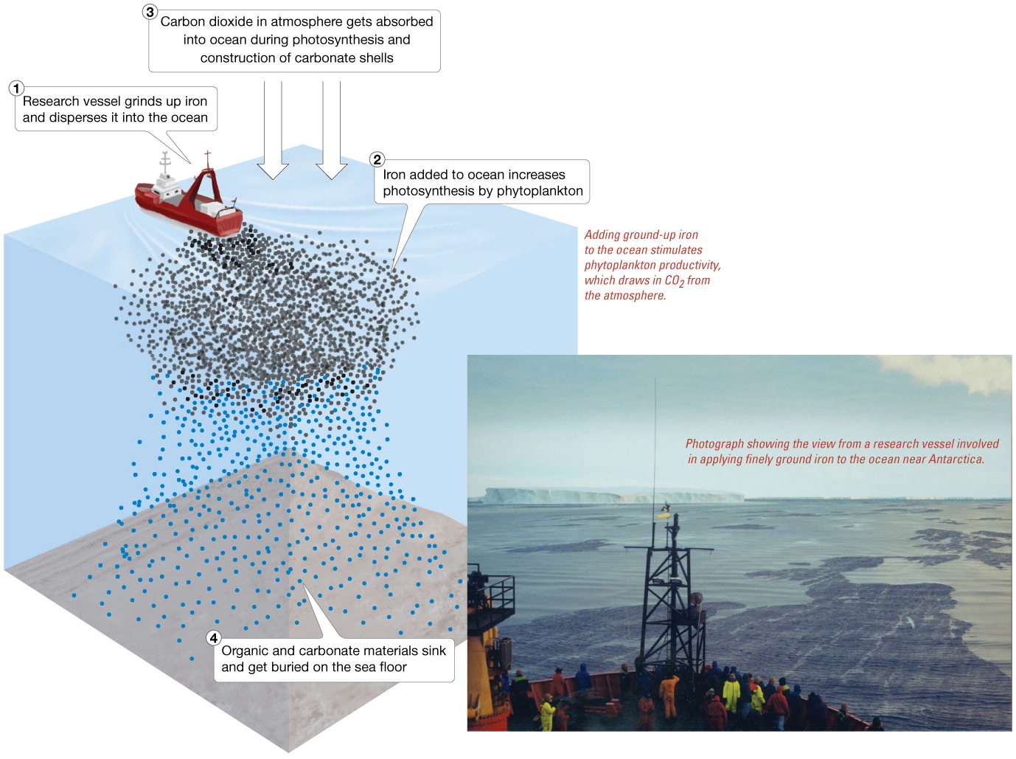
Iron hypothesis

Slide 67
Kyoto Protocol: Limiting Greenhouse Gas Emissions
International agreement – 60 nations
Voluntarily limit greenhouse gases
Even if gas emissions stabilize, Earth will continue to warm.
Commitment to warming
Human activities are altering the global environment.

Slide 68
End of Chapter 16 The Oceans and Climate Change

